Slide 1
Reinforcement Learning: Policy Gradient methods
Instructor: Prof. Yasser Alginahi
Presented By:
Asif Shaik Ajay Guru Madu Lahiri Kanipakam
Date: 17th November, 2023.

Slide 2
Agenda
Overview of learning models
Reinforcement Learning
Classification of Reinforcement Learning
Model based and Model-free Algorithm
Markov Decision Process
REINFORCE Algorithm
Actor-Critic Method
Deep Deterministic policy gradient(DDPG)
DDPG Example
Reference

Slide 3
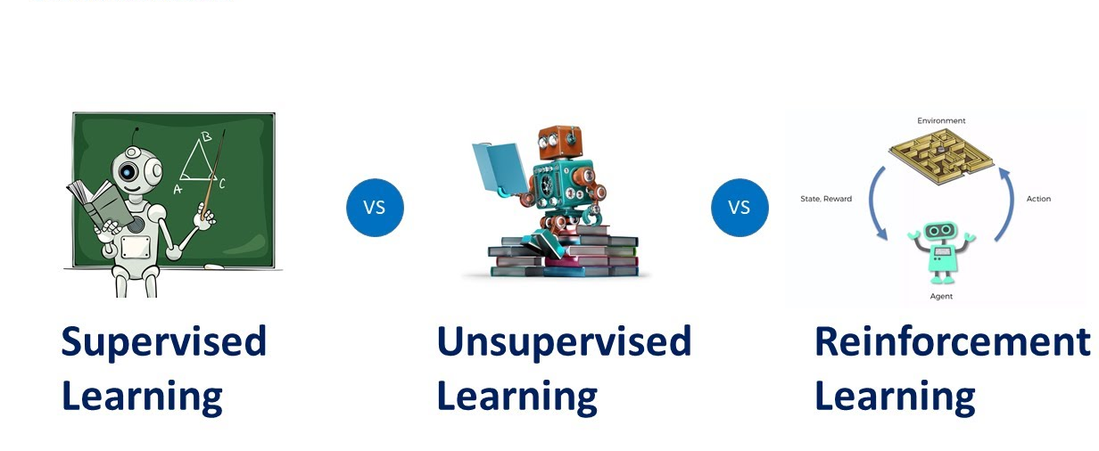
Comparing Supervised, Unsupervised and Reinforcement Learning
Supervised Learning: the goal is to generate formula based on input and output values.
Unsupervised Learning: we find an association between input values and group them.
Reinforcement Learning: an agent learn through delayed feedback by interacting with the environment.
Task driven (Classification/ Regression)
Data driven
(Clustering)
Algorithm learns to react to an environment
https://tinyurl.com/2s83ktye
3

Slide 4
What is Reinforcement Learning?
Reinforcement Learning (RL) is the science of decision making. It is about learning the optimal behavior in an environment to obtain maximum reward. This optimal behavior is learned through interactions with the environment and observations of how it responds, similar to children exploring the world around them and learning the actions that help them achieve a goal.
4

Slide 5

Reinforcement Learning Model
Figure: The agent environment interaction in a Markov decision process
https://tinyurl.com/2m6tc392
5

Slide 6
How Reinforcement Learning is different ?
Delayed Reward
Agent chooses training data
Explore vs Exploit (Lifelong learning)
6

Slide 7
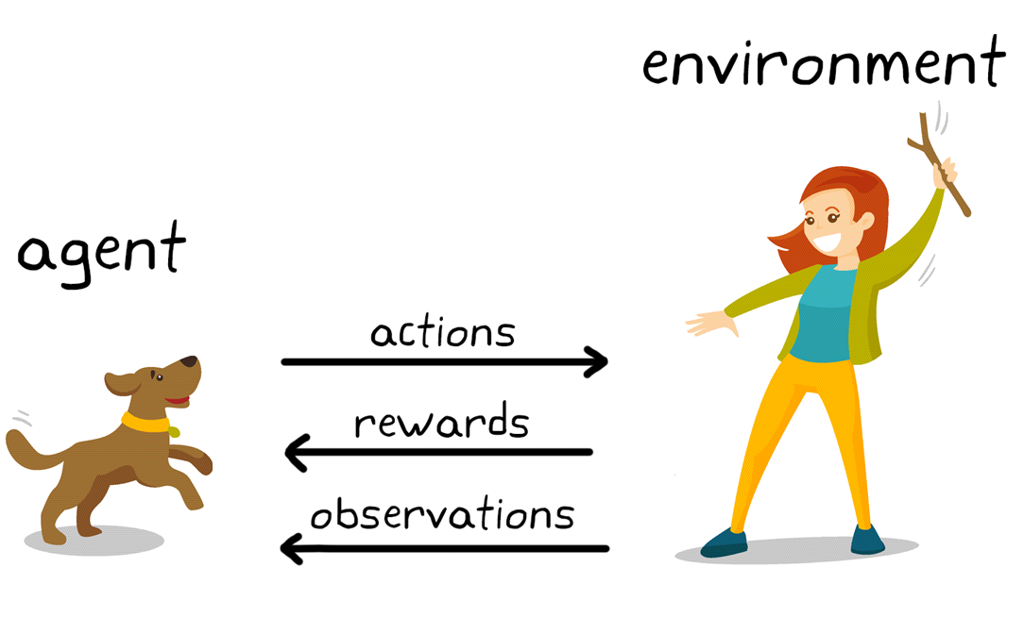
Reinforcement Learning Example
In the realm of reinforcement learning, the goal is to train a dog (the agent) to perform tasks within a specified environment, encompassing both physical surroundings and the trainer.
The ultimate objective is for the dog to develop an optimal policy, maximizing rewards like treats by consistently responding correctly to cues.
https://tinyurl.com/mr3ryfy5
7

Slide 8
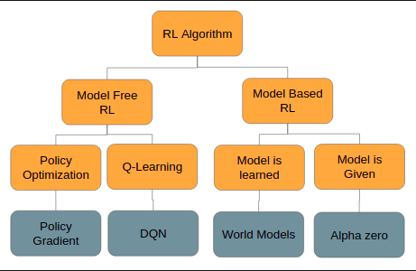
Classification of Reinforcement Learning
https://tinyurl.com/282fpnr2
8

Slide 9
Model based and Model-free
Model-based, as it sounds, has an agent trying to understand its environment and creating a model for it based on its interactions with this environment. In such a system, preferences take priority over the consequences of the actions i.e. the greedy agent will always try to perform an action that will get the maximum reward irrespective of what that action may cause.
Model-free algorithms seek to learn the consequences of their actions through experience via algorithms such as Policy Gradient, Q-Learning, etc. In other words, such an algorithm will carry out an action multiple times and will adjust the policy (the strategy behind its actions) for optimal rewards, based on the outcomes.
9

Slide 10
Markov Decision Processes
A Markov decision process (MDP) refers to a stochastic decision-making process that uses a mathematical framework to model the decision-making of a dynamic system. It is used in scenarios where the results are either random or controlled by a decision maker, which makes sequential decisions over time. MDPs evaluate which actions the decision maker should take considering the current state and environment of the system.
10

Slide 11
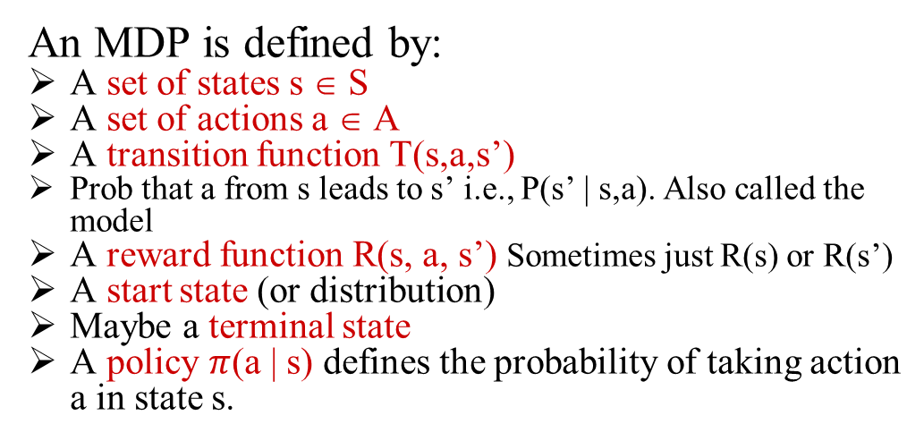
Mathematical expression
$P$($S_{t+1} =s^{′ }| S_{t}=s_{t}, A_{t}=a_{t },S_{t−1}=s_{t−1 }, A_{t−1}, …..S_{0}=s_{0}$
An MDP is defined by:
A set of states s ∈ S
A set of actions a ∈ A
A transition function T(s,a,s’)
Prob that a from s leads to s’ i.e., P(s’ | s,a). Also called the model
A reward function R(s, a, s’) Sometimes just R(s) or R(s’)
A start state (or distribution)
Maybe a terminal state
A policy $π$(a | s) defines the probability of taking action a in state s.
11

Slide 12
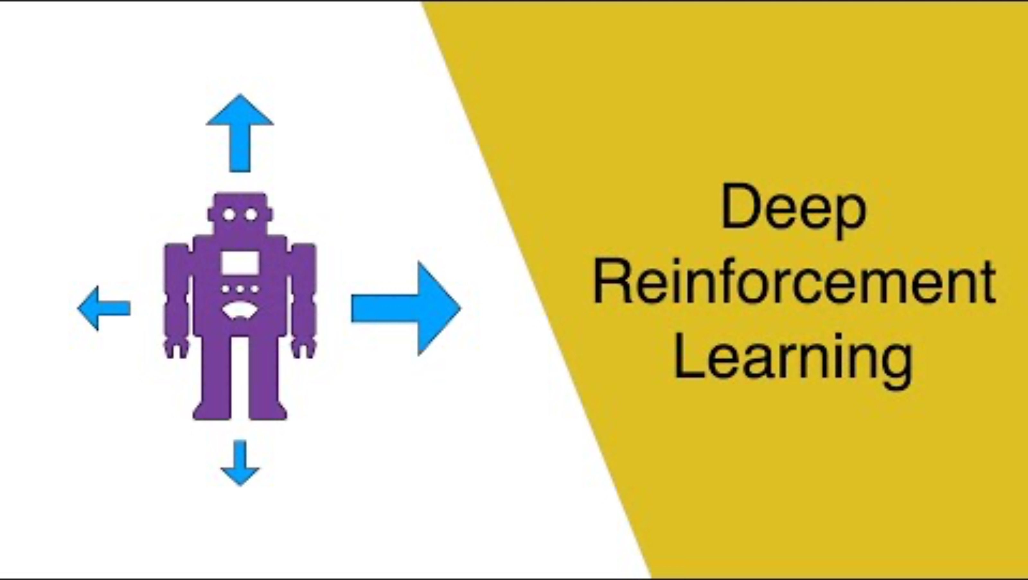
Markov Decision Explained
12

Slide 13
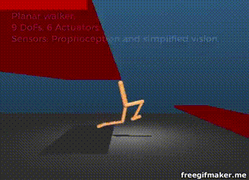
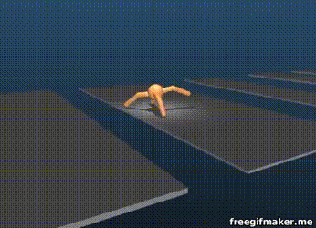
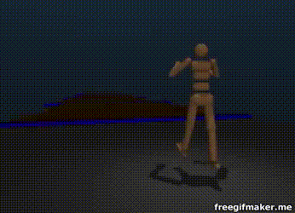
Robotics and Locomotion
State:
Joint States/Velocities
Accelerometer/Gyroscope
Terrain
Actions: Apply Torque to Joints
Reward: Positive(if jumps) else Negative(Retrain)
https://youtu.be/hx_bgoTF7bs
https://arxiv.org/pdf/1707.02286.pdf
13

Slide 14
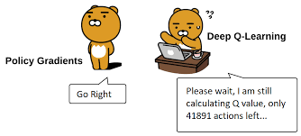
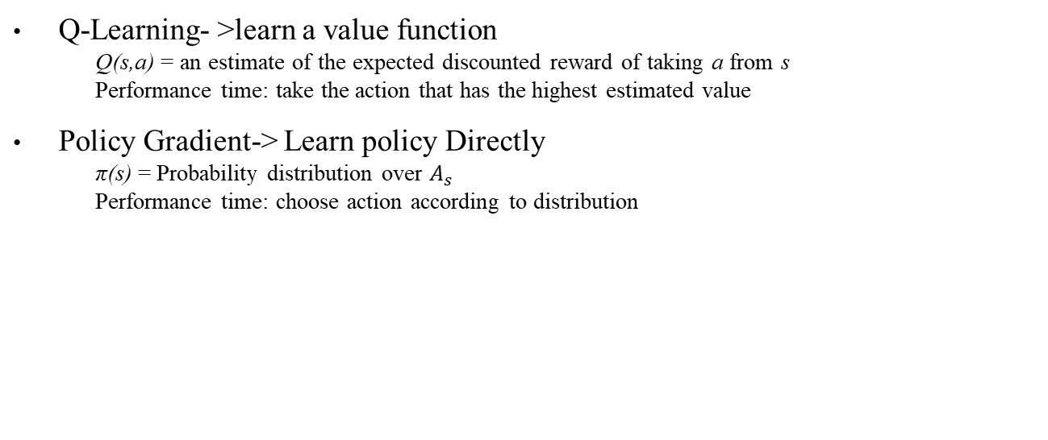
Why Policy Gradient?
Q-Learning- >learn a value function
Q(s,a) = an estimate of the expected discounted reward of taking a from s
Performance time: take the action that has the highest estimated value
Policy Gradient-> Learn policy Directly
π(s) = Probability distribution over $A_{s}$
Performance time: choose action according to distribution
https://tinyurl.com/z3acx6zc
14

Slide 15
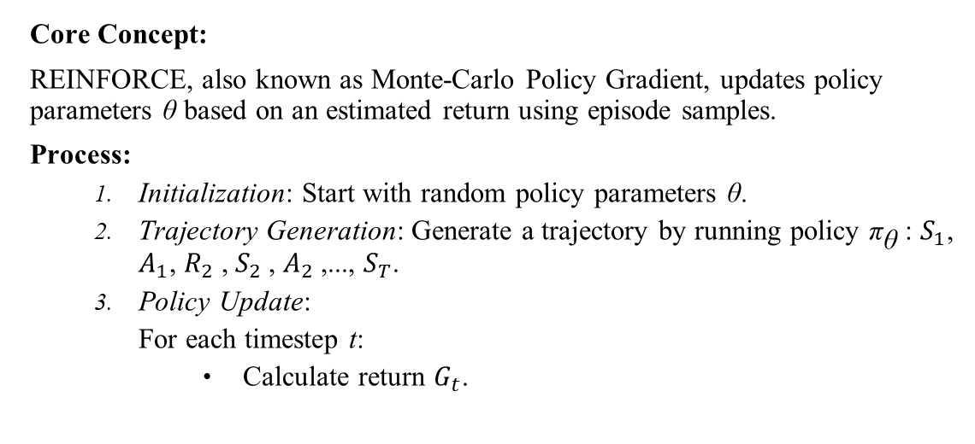
REINFORCE Algorithm
Core Concept:
REINFORCE, also known as Monte-Carlo Policy Gradient, updates policy parameters θ based on an estimated return using episode samples.
Process:
Initialization: Start with random policy parameters θ.
Trajectory Generation: Generate a trajectory by running policy ${\text{π}}_{\text{θ}}$: $S_{1}$​, $A_{1}$, $R_{2}$​, $S_{2}$​, $A_{2}$​,...,​ $S_{T}$.
Policy Update:
For each timestep t:
Calculate return $G_{t}$​.
15

Slide 16
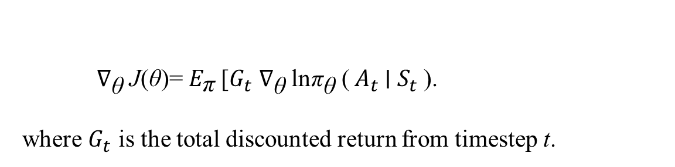
Mathematical Representation:
${\text{∇}}_{\text{θ}}$​J(θ)= $E_{\text{π}}$​[$G_{t} {\text{​}\text{∇}}_{\text{θ}}$ln${\text{π}}_{\text{θ}}$​(​ $A_{t}$∣ $S_{t}$​).
where $G_{t}$ is the total discounted return from timestep t.
16

Slide 17
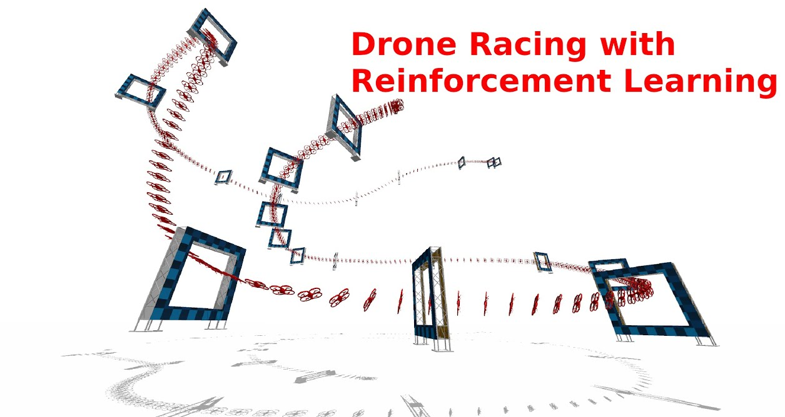
Example of REINFORCE algorithm
Let's say we have a simplified scenario where a drone is learning to fly through a series of waypoints to reach a target. Each action the drone takes is either moving forward, ascending, or descending. The reward is given based on the drone's proximity to the next waypoint—closer proximity yields a higher reward.
For this example, let's consider a single episode where the drone takes three actions to reach the target.
https://tinyurl.com/3be72bh8
17

Slide 18
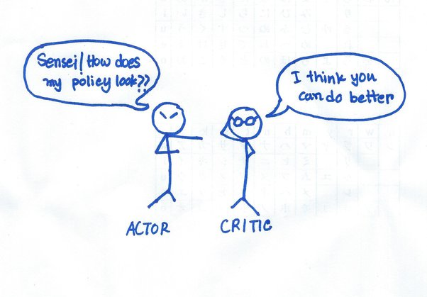
Actor-Critic Method in Reinforcement Learning
Actor (Policy Model):
The actor makes decisions, mapping states to actions.
It is responsible for generating actions in an environment based on a policy.
Critic (Value Model):
The critic assess the actions taken by the actor.
It estimates the value function of the current policy.
https://tinyurl.com/y8fj264m
18

Slide 19
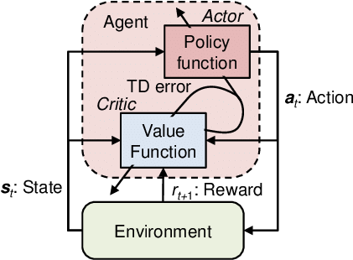
Actor-Critic Method in Reinforcement Learning
Actor: decides which action to take.
Critic : tells the actor how good its action was and how it should adjust.
https://tinyurl.com/ydfsby2f
19

Slide 20
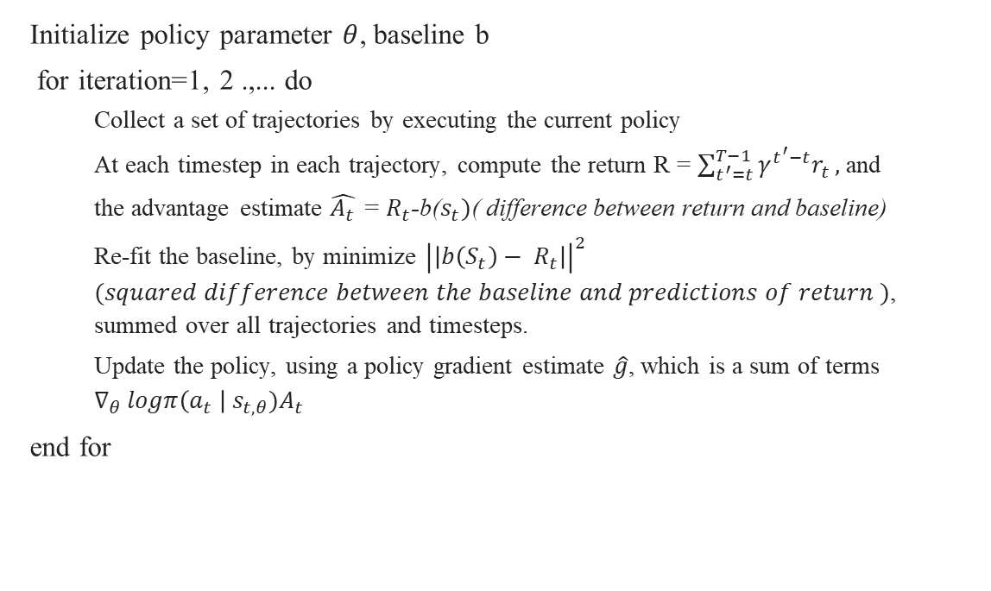
Actor Critic Algorithm
Initialize policy parameter $θ$, baseline b
for iteration=1, 2 .,... do
Collect a set of trajectories by executing the current policy
At each timestep in each trajectory, compute the return R = $\sum_{t^{′}=t}^{T−1}{γ^{t^{′}−t}r_{t}},$and
the advantage estimate $\hat{A_{t}}$ = $R_{t}$-b($s_{t})$( difference between return and baseline)
Re-fit the baseline, by minimize ${\left|\left|b\left(S_{t}\right)− R_{t}\right|\right|}^{2}$ $(squared difference between the baseline and predictions of return )$, summed over all trajectories and timesteps.
Update the policy, using a policy gradient estimate $\hat{g}$, which is a sum of terms $∇_{θ }logπ\left(a_{t} \right| s_{t, θ})A_{t}$
end for
20

Slide 21
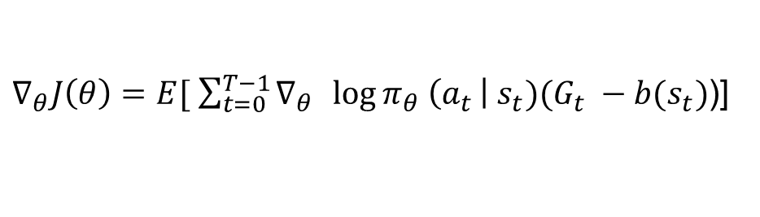
Why Actor Critic and Not REINFORCE??
As in the REINFORCE algorithm, we update the policy parameter through Monte Carlo updates (i.e. taking random samples). This introduces in inherent high variability in log probabilities (log of the policy distribution) and cumulative reward values, because each trajectories during training can deviate from each other at great degrees.
Noisy gradients and high variance.
Reinforce with Baseline:
$∇_{θ}J\left(θ\right)=E[ \sum_{t=0}^{T−1}{∇_{θ}{\log{π_{θ} \left(a_{t }\right| s_{t})(G_{t} −b(s_{t})}}}$)]
21

Slide 22
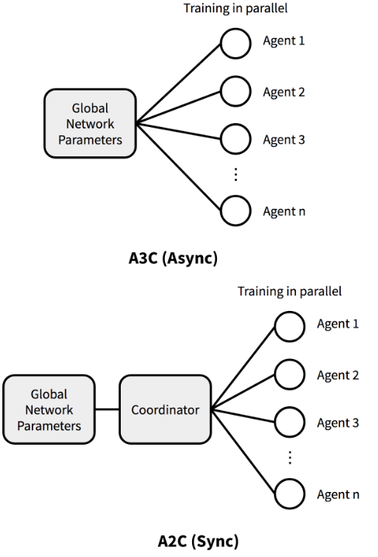
Actor-Critic Methods
Asynchronous Advantage Actor-Critic (A3C) :
Classic policy gradient method with a special focus on parallel training.
Asynchronous nature leads to diverse experience and better policy exploration.
More resource-intensive due to its parallel nature
Less stable
Architecture of A3C
22

Slide 23
Actor-Critic Methods (Contd.)
Advantage Actor-Critic (A2C):
Synchronous: Waits for all agents to finish before updating the policy.
More resource-efficient in terms of computational resources
More stable due to synchronous updates and experience averaging.
Architecture of A3C vs A2C
23

Slide 24
Policy Gradient
Q- Learning can be performed only in discrete action spaces.
Target Networks and Experience replay buffers are used.
Deep Neural networks for efficient learning.
Better convergence rate in the process.
24

Slide 25
Deep Deterministic policy gradient (DDPG)
DDPG is a combination of powerful DRL techniques such as Deep Q learning and Actor- critic algorithms.
DDPG is a DRL algorithm used to solve problems in continuous action spaces.
It is a model free off policy algorithm.
The agent interacts with environment to learn a policy that maximize the cumulative reward.
25

Slide 26
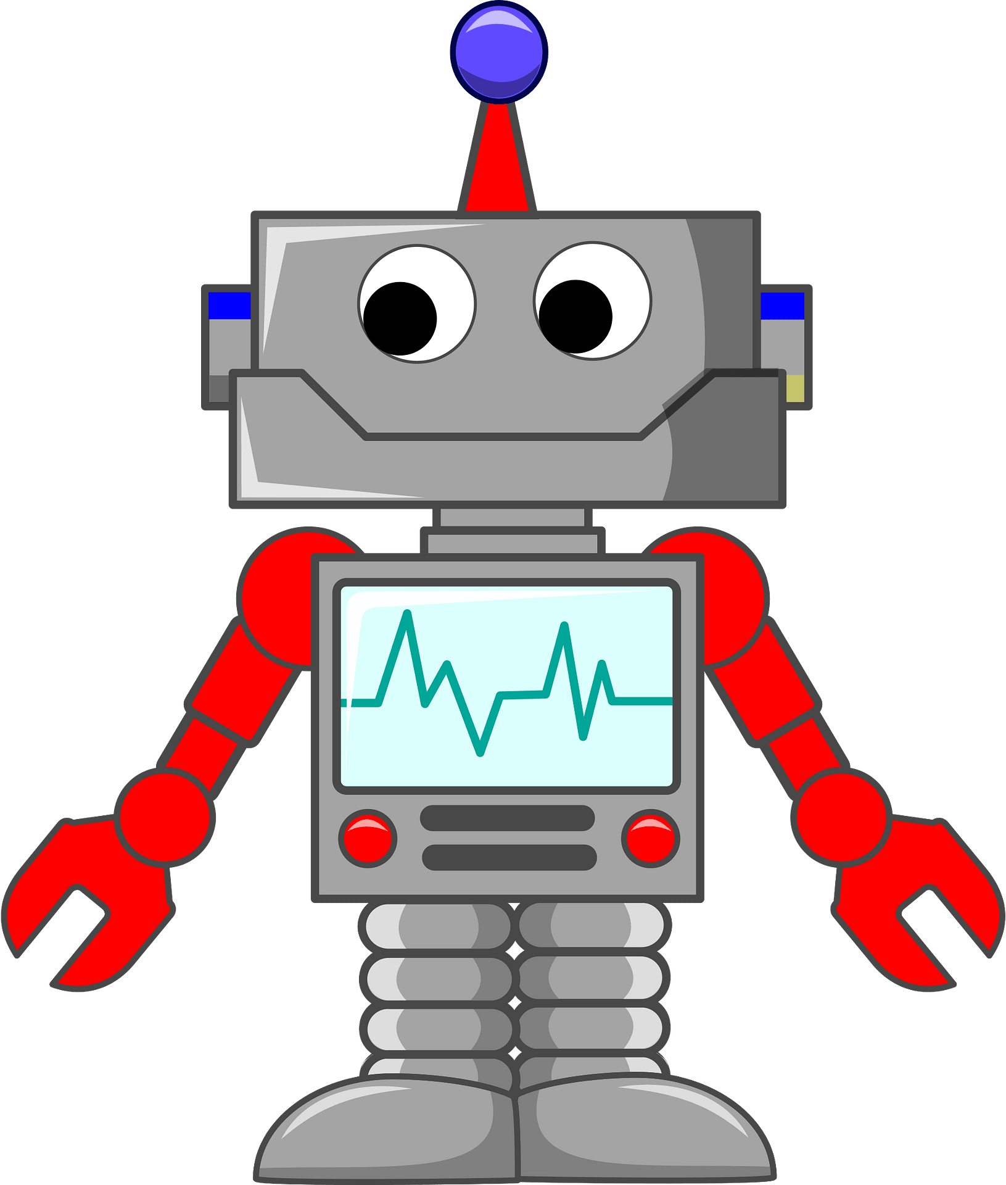
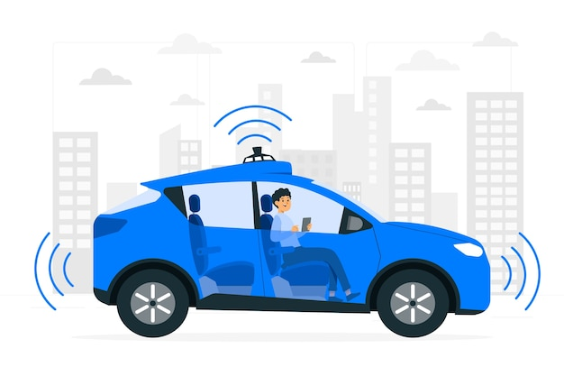

Applications
Robotics(here) Autonomous vehicles(here) Health care(here)
https://tinyurl.com/ypatea3c
https://tinyurl.com/ytm37f6e
https://tinyurl.com/5ue3kwb9
26

Slide 27
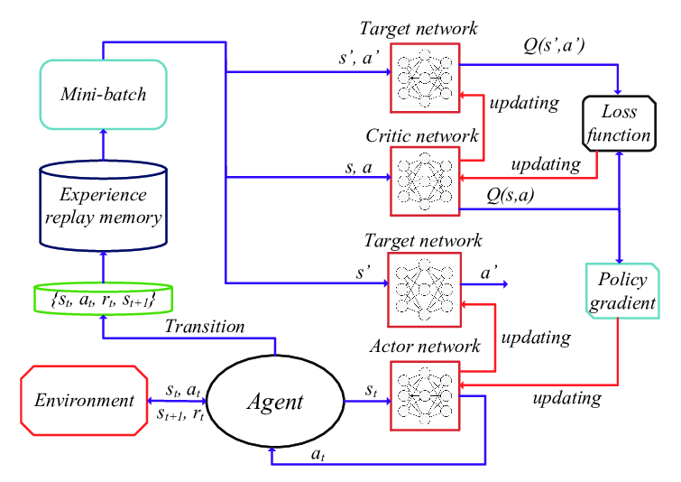
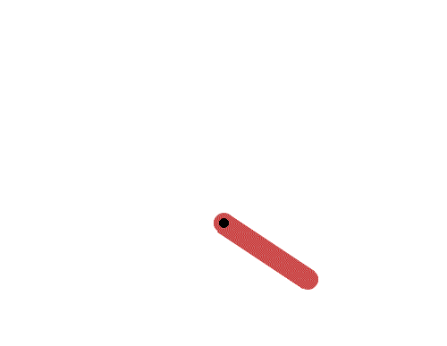
DDPG Architecture
State: X, Y, Angular velocity
Action: Torque
Reward: 1(stands UP) else 0
https://tinyurl.com/bdhwb8jz
https://tinyurl.com/yck59ydp
27

Slide 28
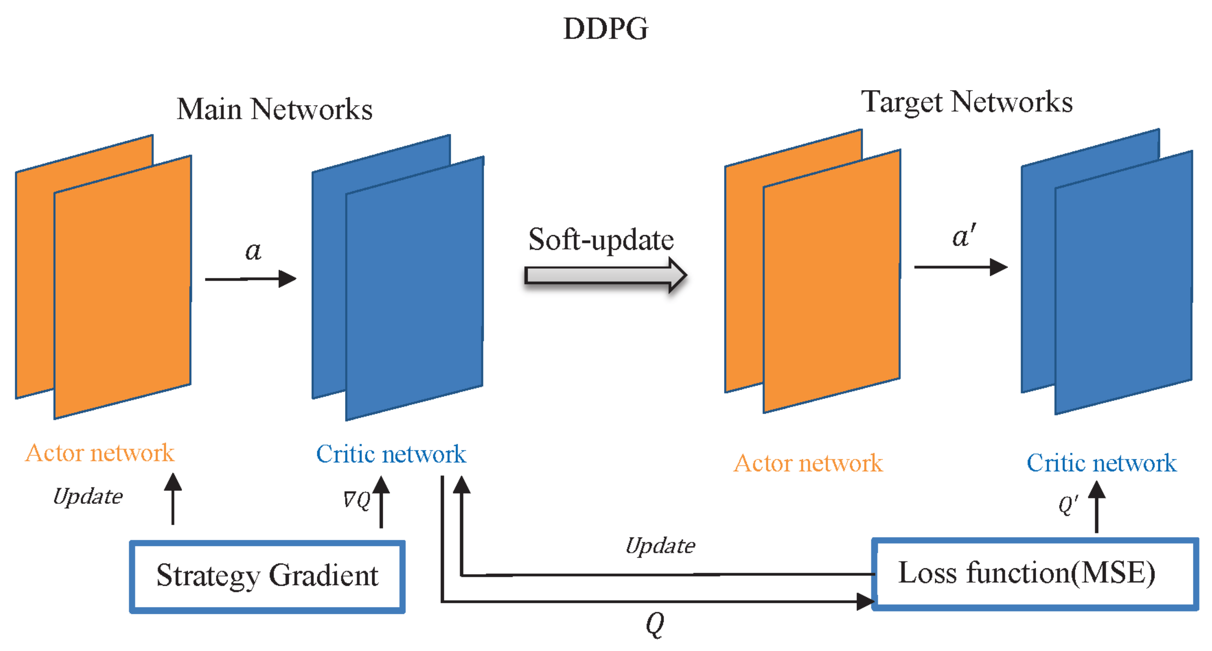
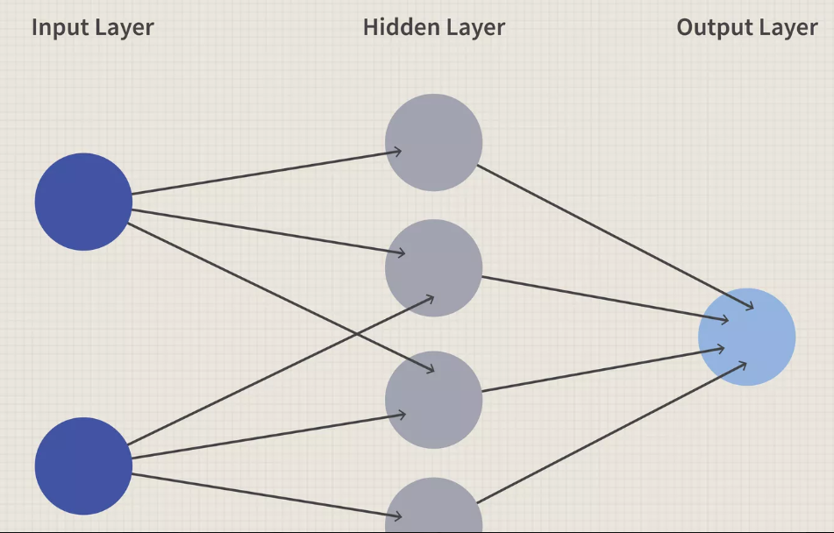
Main and Target Networks
Target Networks:
The old target network parameters and the new corresponding network parameters are weighted, averaged and then assigned to the target networks.
Soft update method (epsilon -greedy, soft-max).
Stabilize the learning process.
https://tinyurl.com/bdsvfxce
28

Slide 29
Main and Target Networks (Contd.)
Policy gradient:
Updates the actor network parameters that gives higher expected rewards.
Loss function:
Minimizes the loss by encouraging the policy to generate actions that leads to maximum rewards.
Measures the error between target and actual values.
29

Slide 30
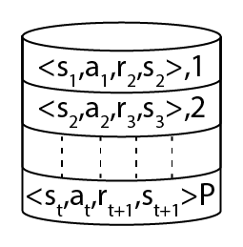
Terms
Replay buffer:
Stores the cumulative transition ( s, a, r, s’) of past experiences.
The agent uses past experiences to learn and get better.
Avoids choosing suboptimal policies.
Noise:
Added to target actor networks.
To make the target actions less deterministic and smooth out the Q value estimates.
https://tinyurl.com/4uh9cy8z
30

Slide 31
DDPG Algorithm
Initialize the actor network and critic network. Initialize the target actor and target critic networks. Initialize the replay buffer. Loop: Noise added for action exploration. Agent interacts with environment from the initial state until terminal state is reached.
7. Observe next state and reward.
8. Store trajectories in a replay buffer for sampling
9. Sample a mini batch of transitions
10. Update Critic network parameters
11. Update Policy network parameters Update Target networks. Repeat steps (4) –(12) Observe the results.
31

Slide 32
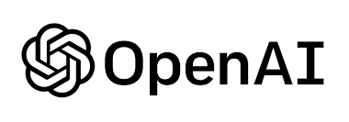
OpenAI Gym Documentation
OpenAI is commonly used in reinforcement learning (RL) as a tool for developing and training RL models.
The documentation includes following functions:
Initialization: Initialize all the parameters that are being used in the code.
Step: It takes the action as input, computes the state of environment and gives a tuple of values.
Reset: Called when the done signal shows up and restarts another episode.
Render: To visualize the results.
Close
https://tinyurl.com/mum5jnc7
32

Slide 33
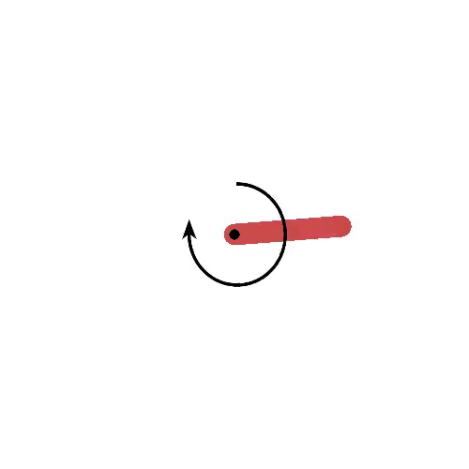
Example:
https://keras.io/examples/rl/ddpg_pendulum/
Results:
33

Slide 34
Conclusion:
Deep Deterministic policy gradient(DDPG) is a combination of Reinforce, Actor- Critic and Deep Q Networks.
A trade-off balance should be maintained between Exploration and Exploitation actions.
34

Slide 35
Reference
Lillicrap, T.P.; Hunt, J.J.; Pritzel, A.; Heess, N.; Erez, T.; Tassa, Y.; Silver, D.; Wierstra, D. “Continuous Control with Deep Reinforcement Learning.” arXiv 2015, arXiv:1509.02971
Silver, D., Lever, G., Heess, N., Degris, T., Wierstra, D., and Riedmiller, M. “Deterministic policy gradient algorithms.” In International Conference on Machine Learning, pp. 387–395, 2014.
R. S. Sutton and A. G. “Barto, Reinforcement Learning: An Introduction, Second.” The MIT Press, 2018 [Online]. Available: http://incompleteideas.net/book/the-book-2nd.html
Tsou, C. X. (2021, August 18). Actor-critic: Implementing actor-critic methods. Medium. https://medium.com/geekculture/actor-critic-implementing-actor-critic-methods-82efb998c273
YouTube. (2020, November 4). Everything you need to know about deep deterministic policy gradients (DDPG) | tensorflow 2 tutorial. YouTube. https://www.youtube.com/watch?v=4jh32CvwKYw
Karunakaran, D. (2020, June 8). Reinforce - a policy-gradient based reinforcement learning algorithm. Medium. https://medium.com/intro-to-artificial-intelligence/reinforce-a-policy-gradient-based-reinforcement-learning-algorithm-84bde440c816#:~:text=Policy%20Gradient%20algorithm,free%20reinforcement%20learning(RL).
Source: D. Silver et al., "Deterministic policy gradient algorithms," in International Conference on Machine Learning, pp. 387-395, 2014.
35

Slide 36


